Slide 1
Unit -1
Spatial Correlation and Convolution

Slide 2
Fundamentals of Spatial Filtering
Spatial filtering is one of the principal tools used in this field for a broad spectrum of applications,
This topic deal mostly with the use of spatial filters for image enhancement.
“filtering” refers to accepting (passing) or rejecting certain frequency components. For example, a filter that passes low frequencies is called a lowpass filter.
The net effect produced by a lowpass filter is to blur (smooth) an image.
We can accomplish a similar smoothing directly on the image itself by using spatial filters (also called spatial masks, kernels, templates, and windows).

Slide 3
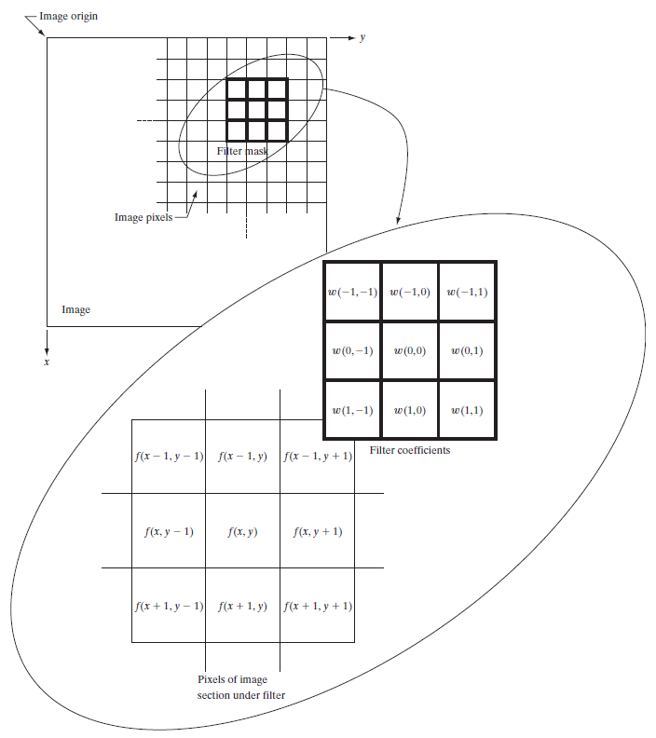
The Mechanics of Spatial Filtering
A spatial filter consists of two things-
A neighborhood, (typically a small rectangle)
A predefined operation that is performed on the image pixels encompassed by the neighborhood.
Filtering creates a new pixel with coordinates equal to the coordinates of the center of the neighborhood, and whose value is the result of the filtering operation
A processed (filtered) image is generated as the center of the filter visits each pixel in the input image.

Slide 4
The Mechanics of Spatial Filtering
At any point (x, y) in the image, the response, g(x,y) , of the filter is the sum of products of the filter coefficients and the image pixels encompassed
by the filter:
g(x, y) = w(-1, -1)f(x - 1, y - 1) + w(-1, 0)f(x - 1, y) + ……+ w(0, 0)f(x, y) + A + w(1, 1)f(x + 1, y + 1)
Observe that the center coefficient of the filter, w(0,0), aligns with the pixel at location (x, y).
For a mask of size m x n we assume that m=2a+1 and n=2b+1 where a and b are positive integers.

Slide 5
Spatial Correlation and Convolution
There are two closely related concepts that must be understood clearly when performing linear spatial filtering. One is correlation and the other is convolution.
Correlation is the process of moving a filter mask over the image and computing the sum of products at each location, exactly as explained in the previous section.
The mechanics of convolution are the same, except that the filter is first rotated by 180°.
https://medium.com/theleanprogrammer/2-dimensional-convolution-189abb174d92

Slide 6
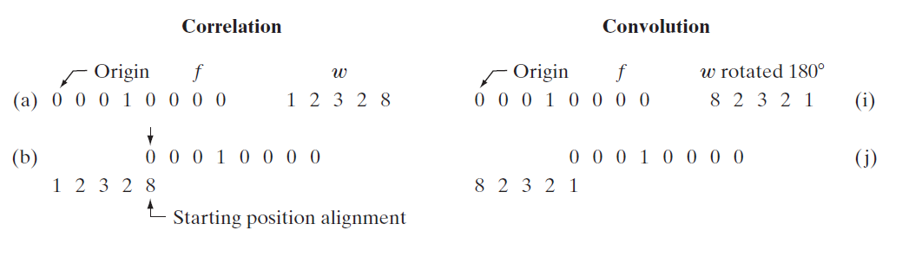
Spatial Correlation and Convolution
Figure (a) shows a 1-D function, f, and a filter, w and figure (b) shows the starting position to perform correlation.
Note that there are parts of the functions that do not overlap.
The solution to this problem is to pad f with enough 0s on either side to allow each pixel in w to visit every pixel in f.
If the filter is of size m, we need m-1 0s on either side of f.

Slide 7
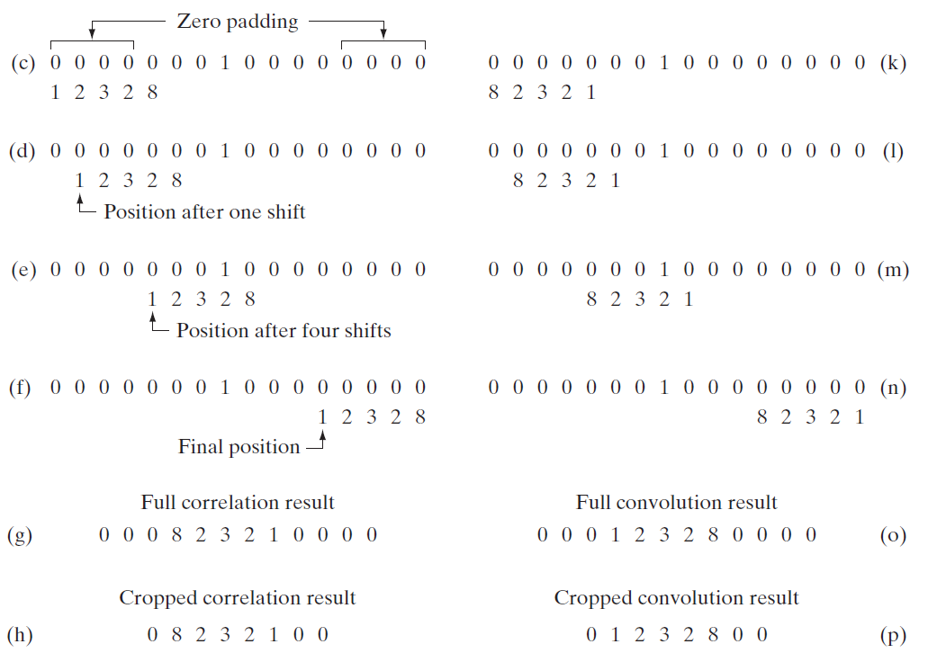
Spatial Correlation and Convolution
The first value of correlation is the sum of products of f and w for the initial position shown in figure ( c ). (the sum of products is 0). This corresponds to a displacement x=0
To obtain the second value of correlation, we shift w one pixel location to the right (a displacement of x=1) and compute the sum of products.

Slide 8
Spatial Correlation and Convolution
There are two important points to note from the discussion in the preceding paragraph-
First, correlation is a function of displacement of the filter.
The second thing to notice is that correlating a filter w with a function that contains all 0’s and a single 1 yields a result that is a copy of w , but rotated by 180⁰.
We call a function that contains a single 1 with the rest being 0s a discrete unit impulse.
So we conclude that correlation of a function with a discrete unit impulse yields a rotated version of the function at the location of the impulse.
Convolving a function with a unit impulse yields a copy of the function at the location of the impulse.

Slide 9
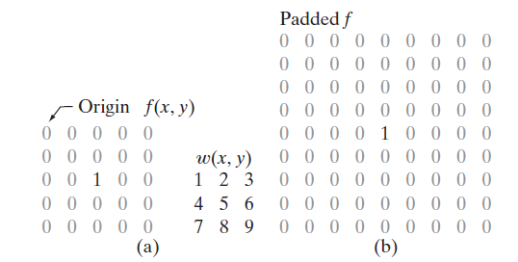
Spatial Correlation and Convolution
The preceding concepts extend easily to images-
For a filter of size m x n we pad the image with a minimum of m-1 rows of 0’s at the top and bottom and n-1 columns of 0’s on the left and right.
m and n are equal to 3, so we pad f with two rows of 0s above and below and two columns of 0s to the left and right,

Slide 10
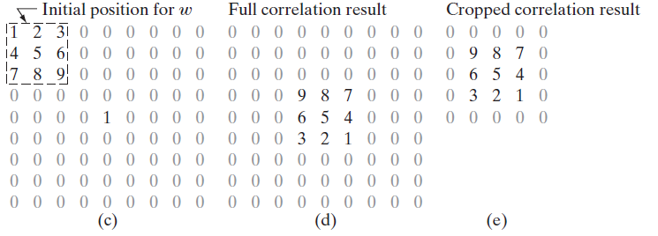
Spatial Correlation on Image
Note again that the result is rotated by 180°.

Slide 11
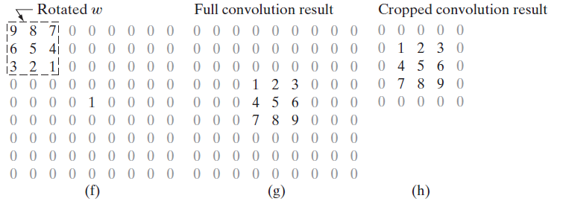
Spatial Convolution on Image
For convolution, we pre-rotate the mask.

Slide 12

Spatial Correlation
Summarizing the preceding discussion in equation form, we have that the correlation of a filter w(x, y) of size m x n with an image f(x, y), denoted as - is given by the equation-
This equation is evaluated for all values of the displacement variables x and y so that all elements of w visit every pixel in f, where we assume that f has been padded appropriately. As explained earlier
a = (m - 1)/2, b = (n - 1)/2, and we assume for notational convenience that m and n are odd integers

Slide 13
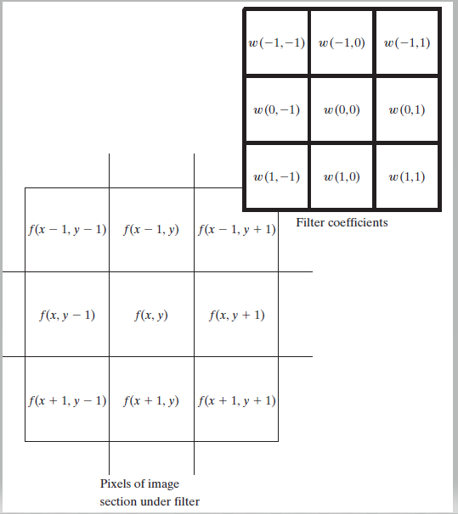
Spatial Correlation
For 3x3, a=1 and b=1
w(s,t), (s=-1 to 1, t=-1 to 1) | f(x,y)
(-1, -1) | (x-1,y-1)
(-1, 0) | (x-1,y)
(-1, 1) | (x-1,y+1)
(0, -1) | (x,y-1)
(0, 0) | (x,y)
(0, 1) | (x,y+1)
(1, -1) | (x+1,y-1)
(1, 0) | (x+1,y)
(1, 1) | (x+1,y+1)

Slide 14

Spatial Convolution
In a similar manner, the convolution of w(x, y) and f(x, y), denoted by w(x, y)⋆ f(x, y), is given by the expression –
where the minus signs on the right flip f (i.e., rotate it by 180°).
w(s,t), (s=-1 to 1, t=-1 to 1) | f(x,y)
(-1, -1) | (x+1,y+1)
(-1, 0) | (x+1,y)
(-1, 1) | (x+1,y-1)
(0, -1) | (x,y+1)
(0, 0) | (x,y)
(0, 1) | (x,y-1)
(1, -1) | (x-1,y+1)
(1, 0) | (x-1,y)
(1, 1) | (x-1,y-1)

Slide 15
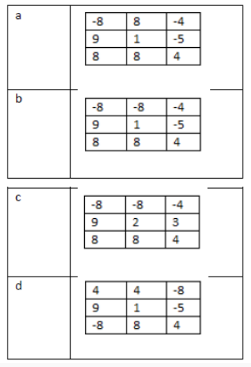
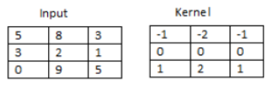
Exercise- convolution
Ans - B
Question: Find the 2D convolution of the given matrices.(Discard padded position so that final answer will be 3X3 matrix)

